Slide 1
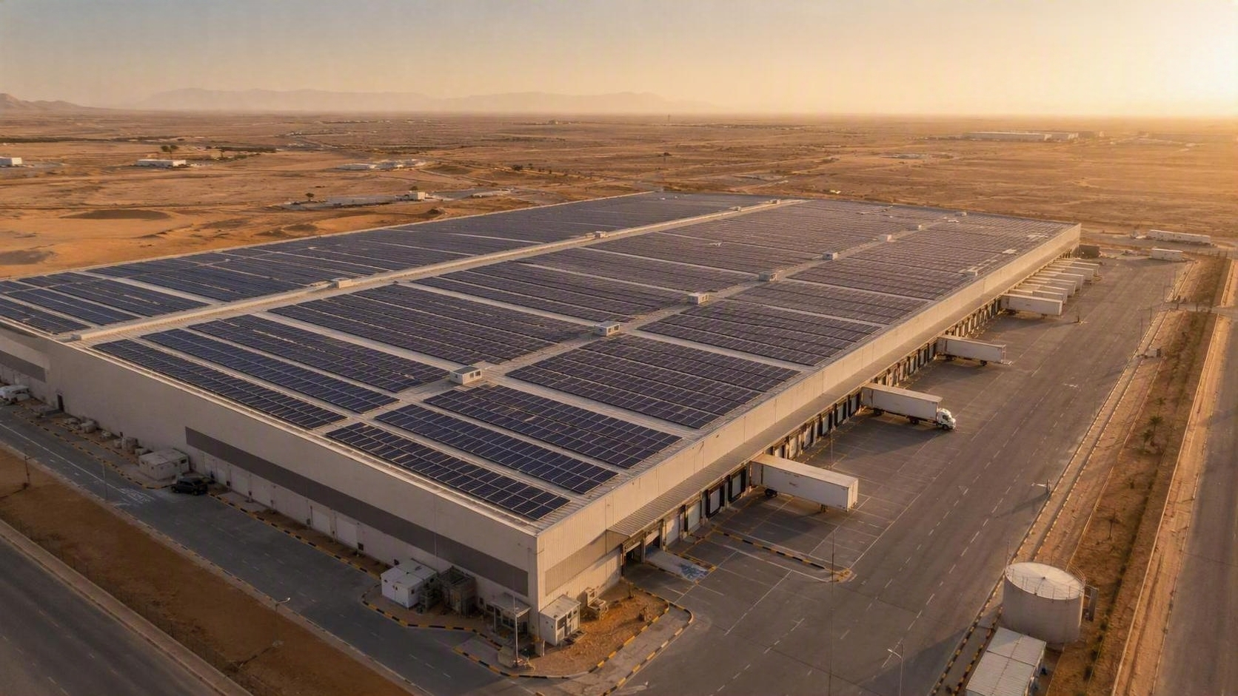
PROJECT PORTFOLIO
Completed Solar PV Projects
Twelve delivered rooftop and ground-mount installations — design, supply, installation and commissioning.
12 PROJECTS · ROOFTOP & GROUND-MOUNT · TURNKEY EPC

Slide 2
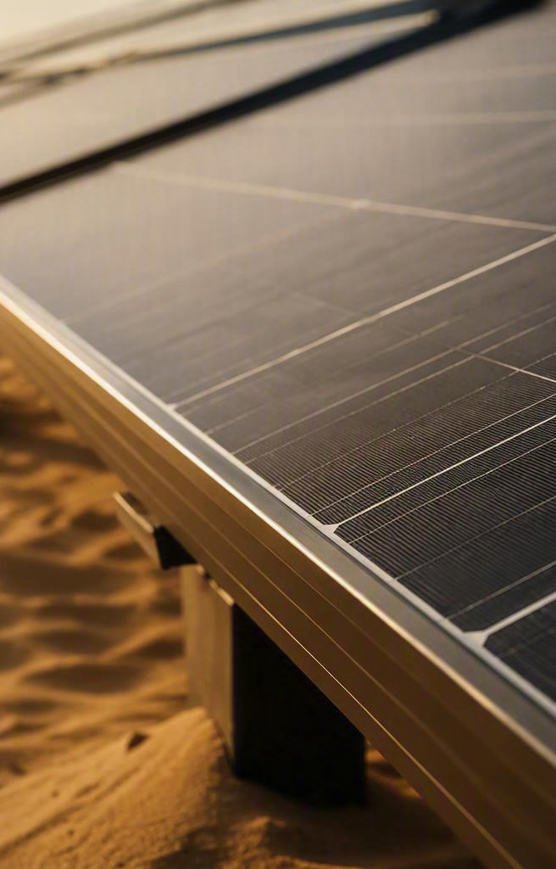
PORTFOLIO AT A GLANCE
A delivery record built on
repeatable execution
Each project below was delivered end to end — feasibility and design, procurement, installation, testing, grid interface and handover — with the same safety and quality standards applied at every site.
12
11.13 MWp
100%
Projects completed
Confirmed to date
Turnkey EPC delivery

Slide 3
COMPLETED PROJECT PORTFOLIO
Projects 01 – 04
Completed installations
01
Amazon Jeddah Solar PV
02
Amazon Riyadh Solar PV
Capacity
2.06 MWp
Capacity
2.6 MWp
Location
Jeddah, Saudi Arabia
Location
Riyadh, Saudi Arabia
Scope
Rooftop solar PV · Turnkey EPC
Scope
Rooftop solar PV · Turnkey EPC
03
04
Golden Chicken Solar PV
04
Project name
Al Jomaih Shell Lubricant Factory
Capacity
5.0 MWp
Capacity
500 KW
Capacity
Location
Jeddah, Saudi Arabia
Location
Saudi Arabia
Location
Scope
Ground Mount Tracking · Turnkey EPC
Scope
Rooftop solar PV · Turnkey EPC
Scope

Slide 4
COMPLETED PROJECT PORTFOLIO
Projects 05 – 08
Completed installations
05
Qiddiya Six flag solar on grid ground mount
06
05
Project name
06
SABIC ON Grid Solar Project
Project name
Capacity
2.0 MWp
Capacity
850 KWp
Capacity
Capacity
Location
Saudi Arabia
Location
Saudi Arabia
Location
Location
Scope
Rooftop solar PV · Turnkey EPC
Scope
Rooftop solar PV · Turnkey EPC
Scope
Scope
07
08
07
Project name
08
Solar traffic monitoring system (BESS)
Solar off Grid Container for Weather stations (BESS)
Project name
Capacity
-
Capacity
-
Capacity
Capacity
Location
Saudi Arabia
Location
Saudi Arabia
Location
Location
Scope
Turnkey EPC
Scope
Turnkey EPC
Scope
Scope

Slide 5
COMPLETED PROJECT PORTFOLIO
Projects 08 – 12
Completed installations
09
Solar off grid container for EV Vehicles (BESS)
10
05
Project name
06
Solar off Grid containers for weather monitoring systems (BESS)
Project name
Capacity
-
Capacity
-
Capacity
Capacity
Location
Jeddah, Saudi Arabia
Location
Jeddah, Saudi Arabia
Location
Location
Scope
Turnkey EPC
Scope
Turnkey EPC
Scope
Scope
07
12
11
Project name
08
STC – Parking Area
Solar Water Heater – KAFD
Project name
Capacity
-
Capacity
100 KWp
Capacity
Capacity
Location
Jeddah, Saudi Arabia
Location
Jeddah, Saudi Arabia
Location
Location
Scope
Turnkey EPC
Scope
Rooftop solar PV · Turnkey EPC
Scope
Scope

Slide 6
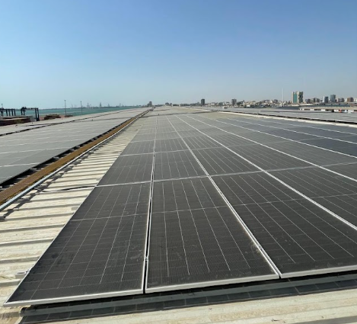
PROJECT 01
Amazon Jeddah Solar PV
2.0 MWp · Jeddah, Saudi Arabia
PROJECT DESCRIPTION
A Rooftop Solar PV project at Amazon, Jeddah, Saudi Arabia. Delivered as a Turnkey EPC project to support clean and renewable energy generation.
Add project image here
KEY FACTS
Capacity
2.06 MWp
Location
Jeddah, Saudi Arabia
Scope
Turnkey EPC
Status
Completed

Slide 7
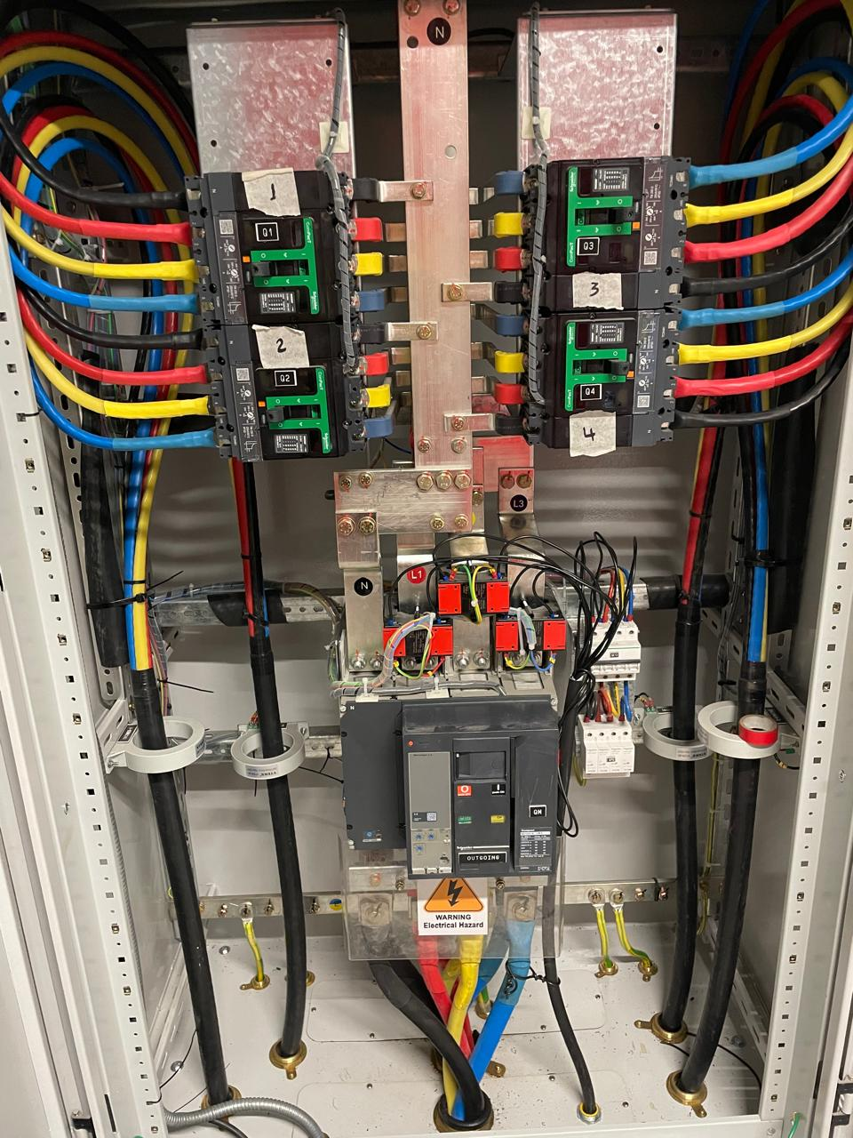
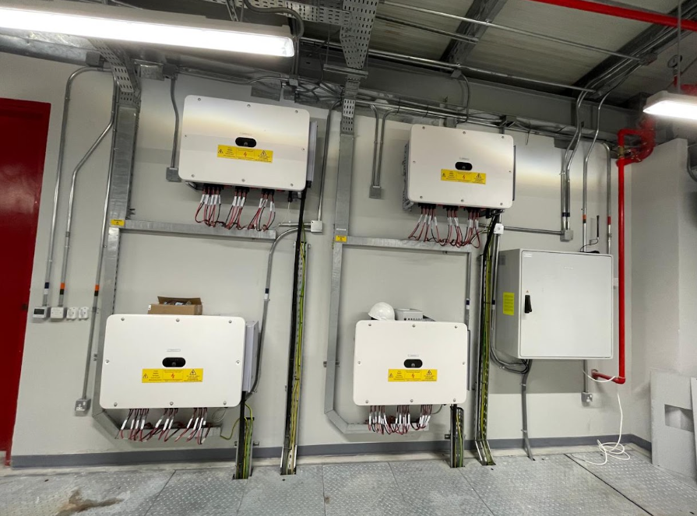
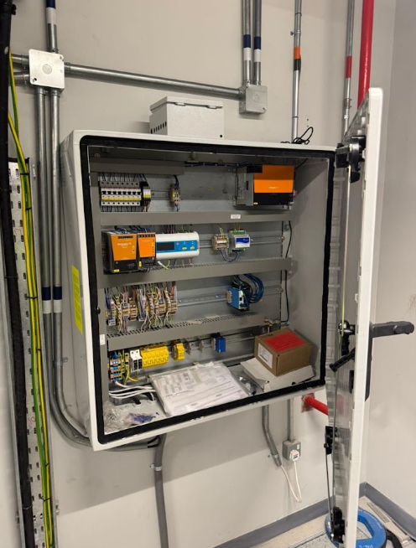
PROJECT 01 · SITE GALLERY
Amazon Jeddah Solar PV
Images & delivery notes
Add image
Add image
Add image
DELIVERY NOTES
Successfully delivered and Supported the installation of the Solar PV Project, ensuring safe, timely, and efficient project execution in line with required quality and safety standards

Slide 8
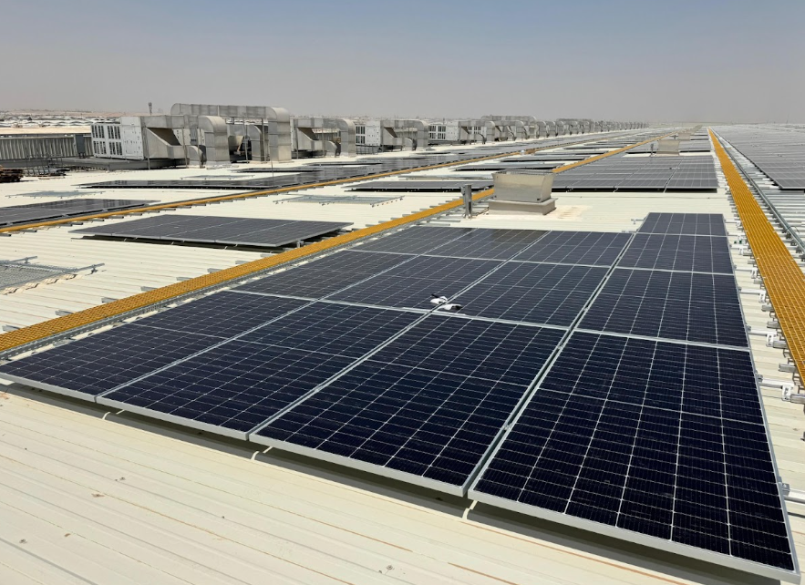
PROJECT 02
Amazon Riyadh Solar PV
2.6 MWp · Riyadh, Saudi Arabia
PROJECT DESCRIPTION
Solar PV Installation project focused on delivery a reliable and efficient energy solution for Amazon’s Riyadh facility.
Add project image here
KEY FACTS
Capacity
2.6 MWp
Location
Riyadh, Saudi Arabia
Scope
Turnkey EPC
Status
Completed

Slide 9
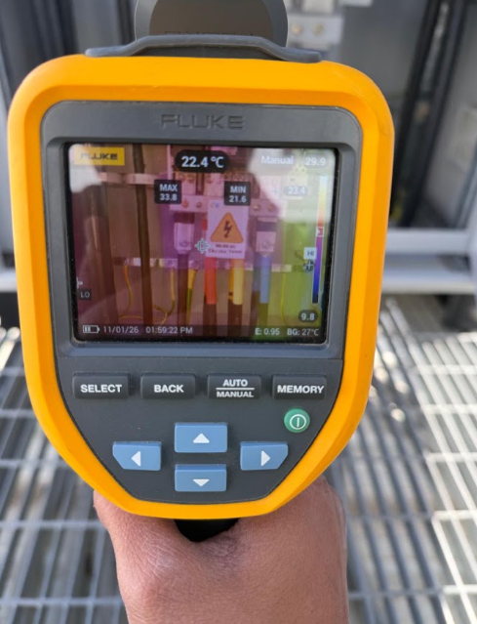
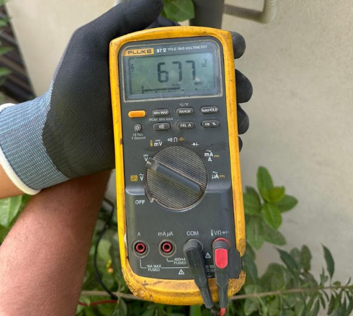
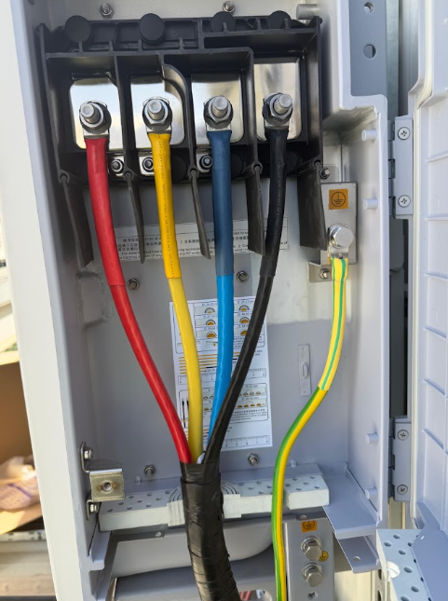
PROJECT 02 · SITE GALLERY
Amazon Riyadh Solar PV
Images & delivery notes
Add image
Add image
Add image
DELIVERY NOTES
Successfully delivered the project with a focus on quality, Safety, and timely execution,

Slide 10
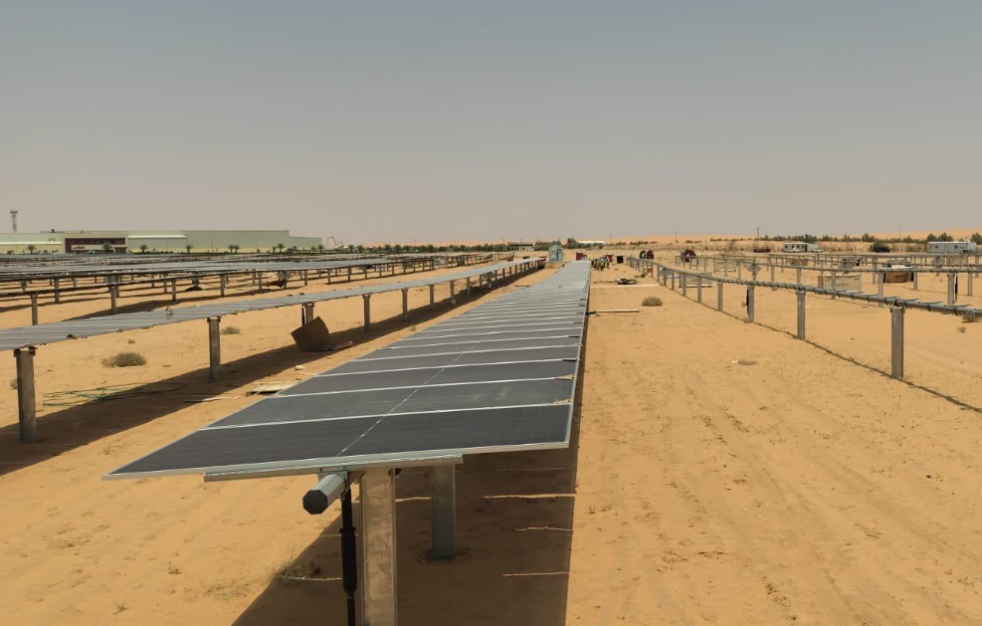
PROJECT 03
Golden Chicken Solar PV
Completed project
PROJECT DESCRIPTION
A Solar PV project designed to harness clean energy and reduce conventional power consumption at the Golden Chicken facility
Add project image here
KEY FACTS
Capacity
2.6 MWp
Location
Shaqra,KSA
Scope
Turnkey EPC
Status
Completed

Slide 11
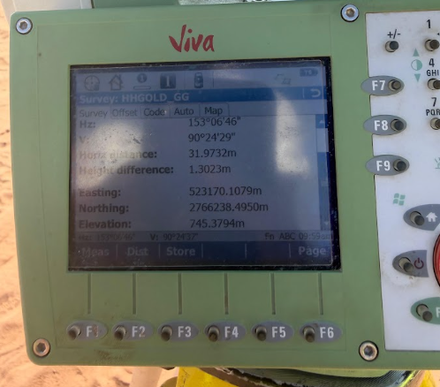
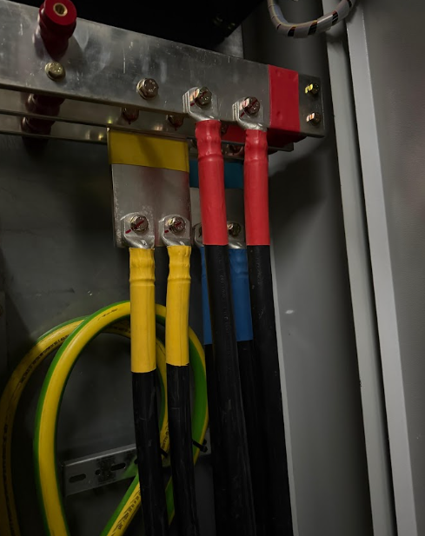
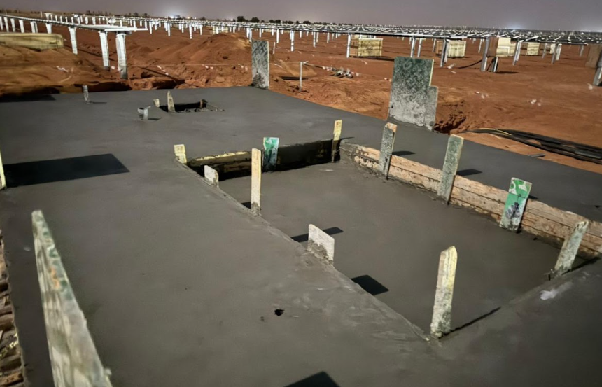
PROJECT 03 · SITE GALLERY
Golden Chicken Solar PV
Images & delivery notes
Add image
Add image
Add image
DELIVERY NOTES
The project was successfully completed and handed over, meeting the required project, safety, and quality standards.

Slide 12
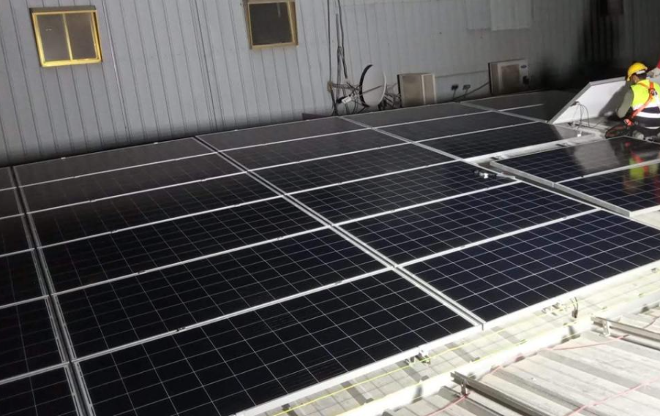
PROJECT 04
Al Jomaih Shell Lubricant Factory
Completed project
PROJECT DESCRIPTION
Solar PV installation for an industrial lubricant manufacturing factory, Designed to maximize on-site renewable energy generation and improve energy efficiency.
Add project image here
KEY FACTS
Capacity
500 KW
Location
Saudi Arabia
Scope
Turnkey EPC
Status
Completed

Slide 13
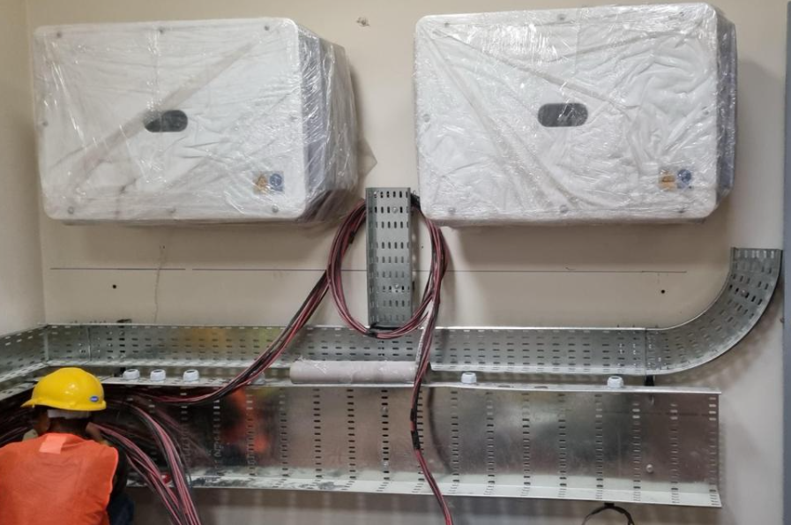
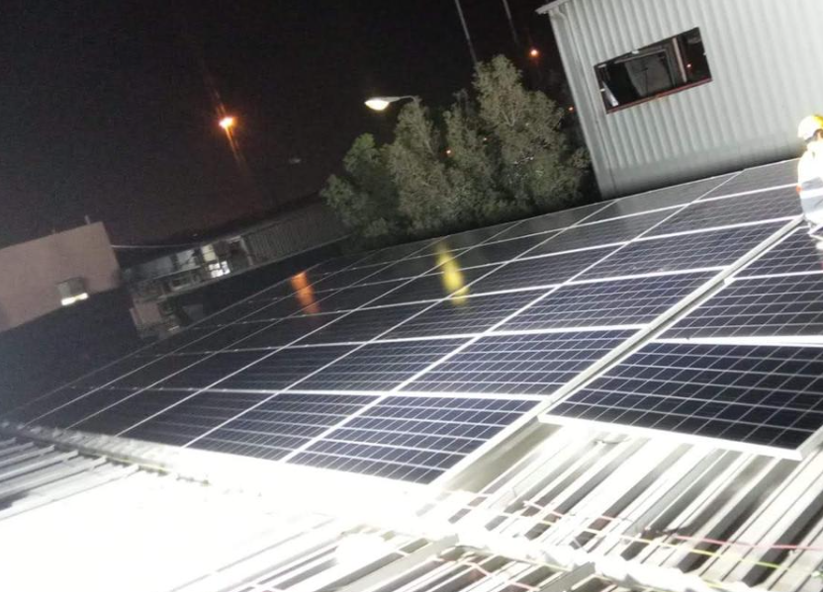
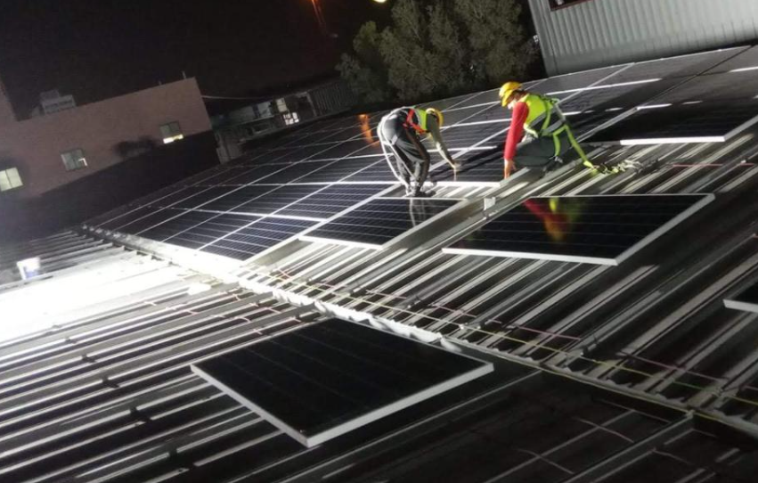
PROJECT 04 · SITE GALLERY
Images & delivery notes
Al Jomaih Shell Lubricant Factory
Add image
Add image
Add image
DELIVERY NOTES
Successfully completed and delivered with a focus on safe installation, quality workmanship and reliable system.

Slide 14
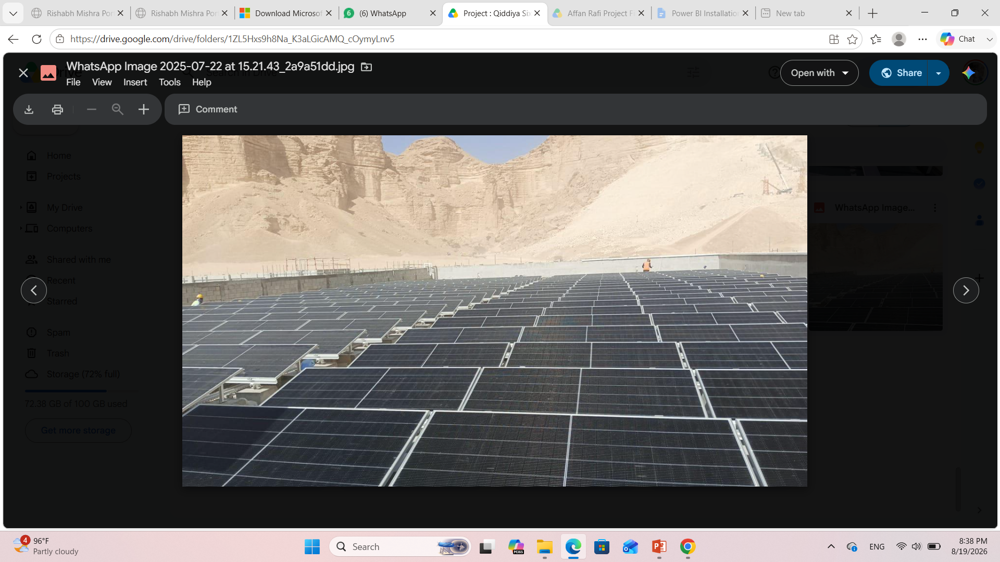
PROJECT 05
Qiddiya Six flags Solar On Grid Ground Mount
Completed project
PROJECT DESCRIPTION
Write the project description here — scope of works, system design, site conditions, timeline and outcome.
Add project image here
KEY FACTS
Capacity
500 KW
Location
Saudi Arabia
Scope
Turnkey EPC
Status
Completed

Slide 15
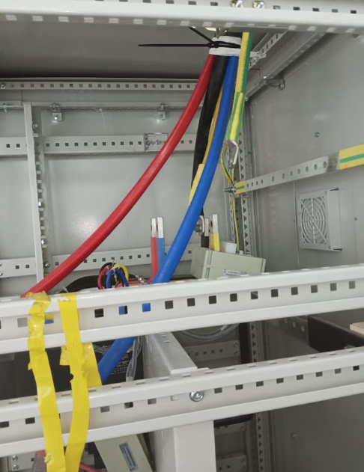
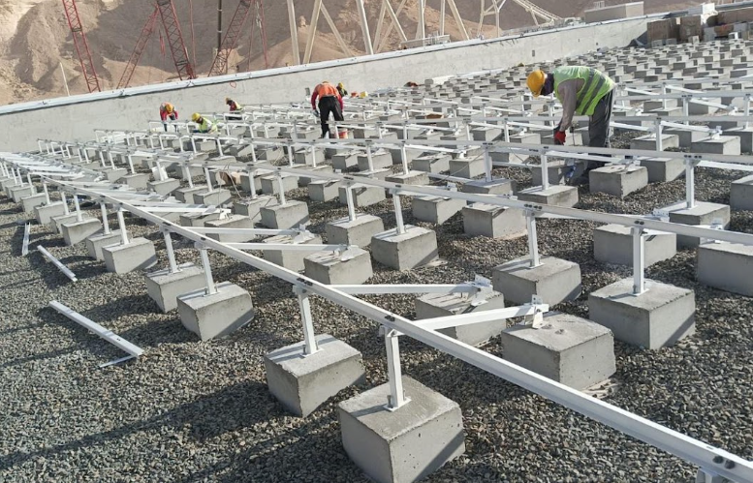
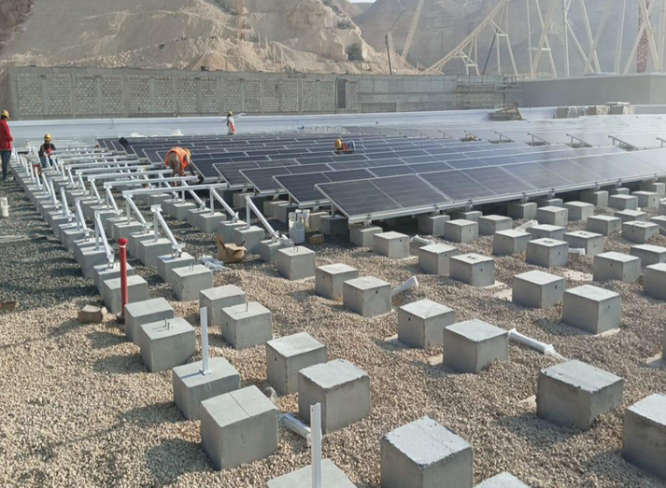
PROJECT 05 · SITE GALLERY
Qiddiya Six flags Solar On Grid Ground Mount
Images & delivery notes
Add image
Add image
Add image
DELIVERY NOTES
Add notes here — installation highlights, engineering challenges solved, performance results and client feedback.

Slide 16
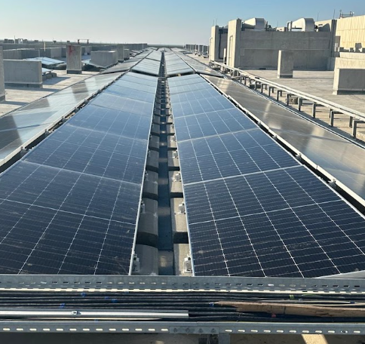
PROJECT 06
SABIC ON grid Solar PV
Completed project
PROJECT DESCRIPTION
Large-scale 850 kWp grid-connected solar PV system developed for SABIC, designed to maximize on-site renewable energy generation and reduce dependence on conventional electricity sources. The project involved solar PV system design, equipment integration, installation, testing, and commissioning. timeline and outcome.
Add project image here
KEY FACTS
Capacity
500 KW
Location
Saudi Arabia
Scope
Turnkey EPC
Status
Completed

Slide 17
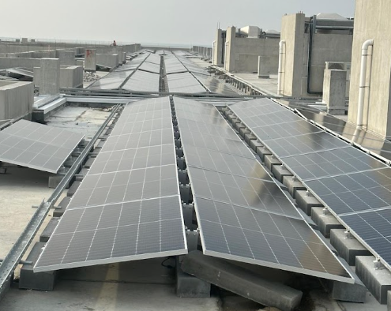
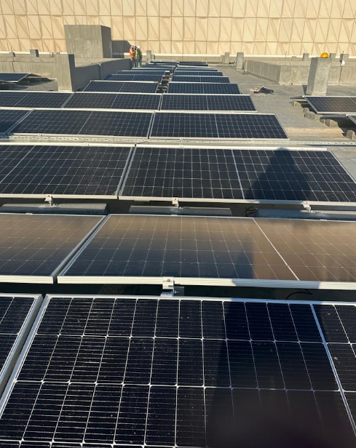
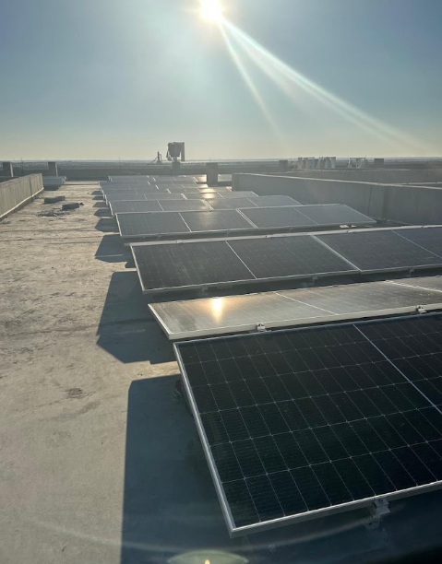
PROJECT 06 · SITE GALLERY
Images & delivery notes
SABIC ON grid Solar PV
Add image
Add image
Add image
DELIVERY NOTES
Successfully delivered and commissioned the complete solar PV solution, ensuring reliable grid synchronization, system performance, and compliance with project technical and safety requirements

Slide 18
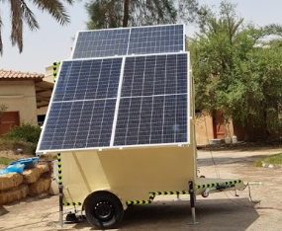
PROJECT 07
Solar off Grid container for weather stations
Completed project
PROJECT DESCRIPTION
Engineered a stand-alone solar power container solution to provide reliable, continuous energy for remote weather monitoring stations. The system integrates solar generation, battery storage, power management, and supporting electrical equipment for operation in remote environments. outcome.
Add project image here
KEY FACTS
Capacity
500 KW
Location
Saudi Arabia
Scope
Turnkey EPC
Status
Completed

Slide 19
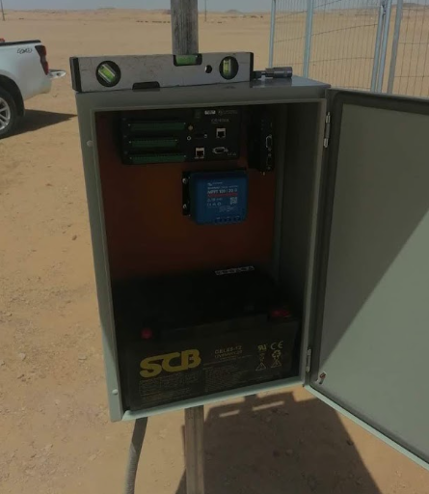
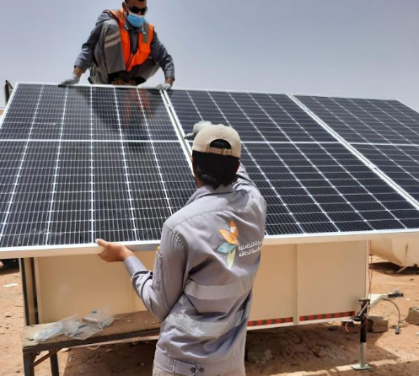
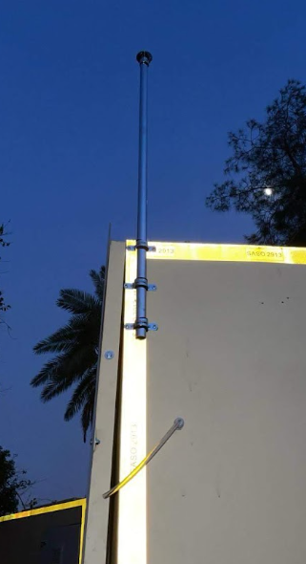
PROJECT 07 · SITE GALLERY
Images & delivery notes
Solar off Grid container for weather stations
Add image
Add image
Add image
DELIVERY NOTES
Delivered a complete plug-and-play off-grid power solution, optimized for autonomous operation, remote deployment, and dependable performance with minimal maintenance requirements.

Slide 20
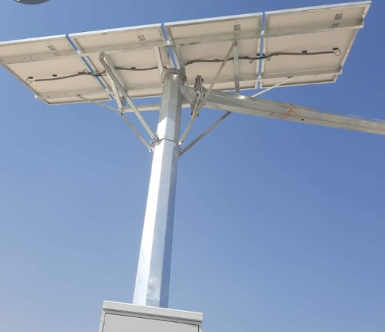
PROJECT 08
Solar Traffic Monitoring System
Completed project
PROJECT DESCRIPTION
Developed a solar-powered traffic monitoring solution for remote and infrastructure locations where conventional grid power is unavailable or impractical. The system provides autonomous power for traffic monitoring and associated communication equipment.
Add project image here
KEY FACTS
Capacity
500 KW
Location
Saudi Arabia
Scope
Turnkey EPC
Status
Completed

Slide 21
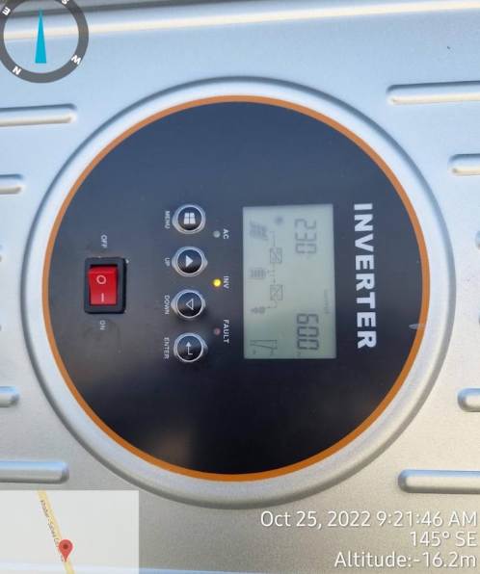
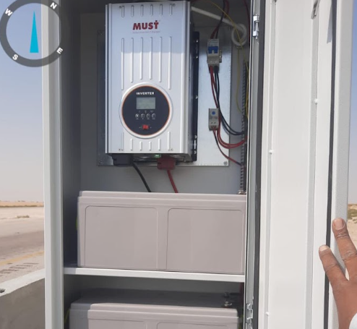
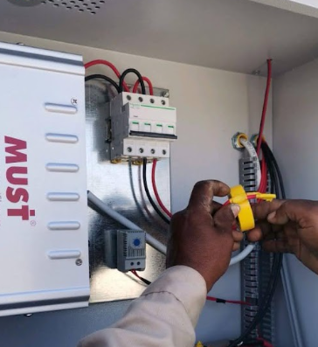
PROJECT 08 · SITE GALLERY
Solar Traffic Monitoring System
Images & delivery notes
Add image
Add image
Add image
DELIVERY NOTES
Successfully delivered an integrated renewable-energy solution combining solar PV, energy storage, power management, and monitoring equipment, enabling reliable 24/7 operation.

Slide 22
PROJECT 09
Off-Grid Solar Container for EV Vehicles
Completed project
PROJECT DESCRIPTION
Designed and delivered an off-grid solar container solution supporting electric vehicle (EV) applications, integrating renewable energy generation and energy storage to provide an independent power source for EV charging infrastructure.
Add project image here
KEY FACTS
Capacity
500 KW
Location
Saudi Arabia
Scope
Turnkey EPC
Status
Completed

Slide 23
PROJECT 09 · SITE GALLERY
Off-Grid Solar Container for EV Vehicles
Images & delivery notes
Add image
Add image
Add image
DELIVERY NOTES
Delivered a complete and scalable solar-powered energy system, providing clean, independent power for EV applications while reducing reliance on conventional grid infrastructure.

Slide 24
PROJECT 10
Off-Grid Solution - Weather Monitoring Systems
Completed project
PROJECT DESCRIPTION
Implemented a stand-alone solar energy solution for weather monitoring systems, providing dependable power to remote sensing, data acquisition, communication, and monitoring equipment.
Add project image here
KEY FACTS
Capacity
500 KW
Location
Saudi Arabia
Scope
Turnkey EPC
Status
Completed

Slide 25
PROJECT 10 · SITE GALLERY
Images & delivery notes
Off-Grid Solution - Weather Monitoring Systems
Add image
Add image
Add image
DELIVERY NOTES
Successfully delivered a reliable off-grid power system incorporating solar PV, battery storage, charge control, and power distribution, enabling continuous operation in remote locations.

Slide 26
PROJECT 11
KAFD – Solar Water Heater Project
Completed project
PROJECT DESCRIPTION
Solar thermal project at King Abdullah Financial District (KAFD) utilizing solar energy for efficient water heating. The solution was designed to improve energy efficiency and reduce conventional energy consumption through renewable thermal technology
Add project image here
KEY FACTS
Capacity
500 KW
Location
Saudi Arabia
Scope
Turnkey EPC
Status
Completed

Slide 27
PROJECT 11 · SITE GALLERY
KAFD – Solar Water Heater Project
Images & delivery notes
Add image
Add image
Add image
DELIVERY NOTES
Successfully delivered the solar water heating solution with focus on system efficiency, reliable operation, installation quality, and integration with the site's existing infrastructure.

Slide 28
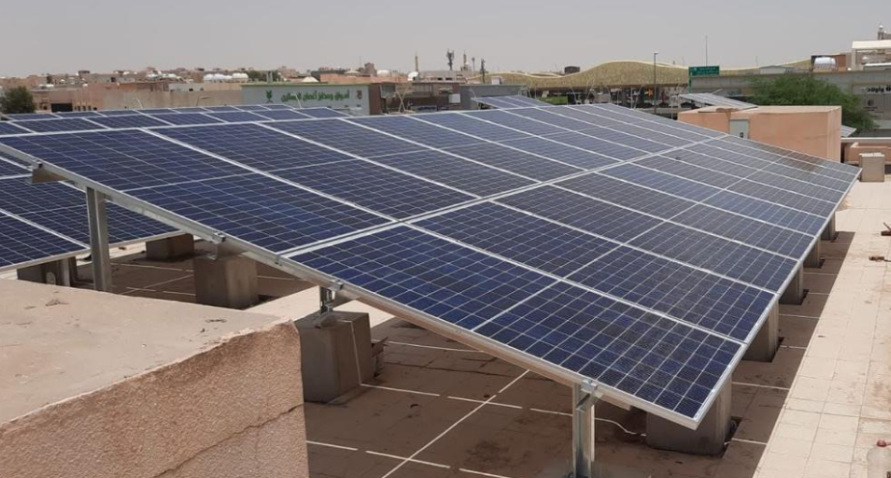
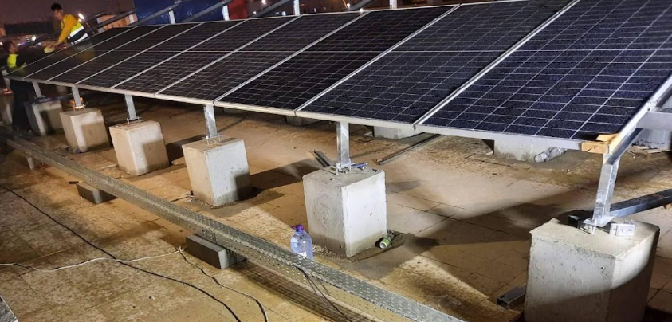
PROJECT 12
STC – Rooftop Solar PV Project
Completed project
PROJECT DESCRIPTION
50 kWp rooftop solar PV installation for STC, utilizing available rooftop space to generate clean electricity and improve the facility's renewable energy contribution. The project included system integration, installation, testing, and commissioning.
Add project image here
KEY FACTS
Capacity
500 KW
Location
Saudi Arabia
Scope
Turnkey EPC
Status
Completed

Slide 29
PROJECT 12 · SITE GALLERY
STC – Rooftop Solar PV Project
Images & delivery notes
Add image
Add image
Add image
DELIVERY NOTES
Successfully delivered and commissioned the rooftop PV system, ensuring safe installation, efficient energy generation, reliable grid integration, and compliance with project requirements.

Slide 30
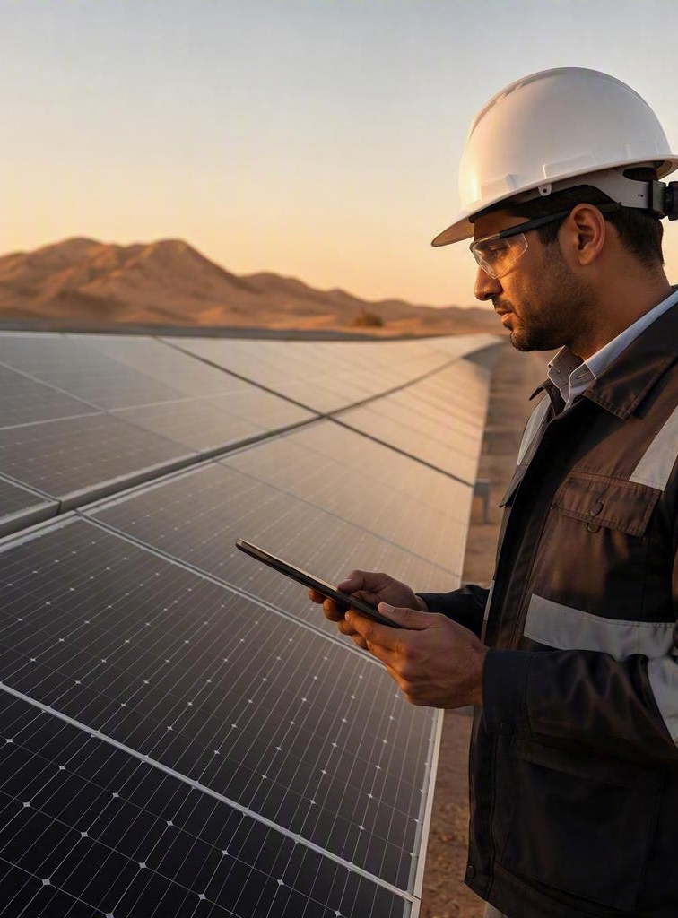
HOW WE DELIVER
One delivery model, applied
to every project
01
Assess & design
Site survey, yield modelling and structural review.
02
Procure & build
Tier-one supply, safe installation, quality control.
03
Commission & support
Testing, grid interface, handover and aftercare.

